Slide 1
2023 ACC GUIDELINES FOR
ATRIAL FIBRILLATION
Presenter: Dr Abhiman Shetty B
Senior Resident

Slide 2
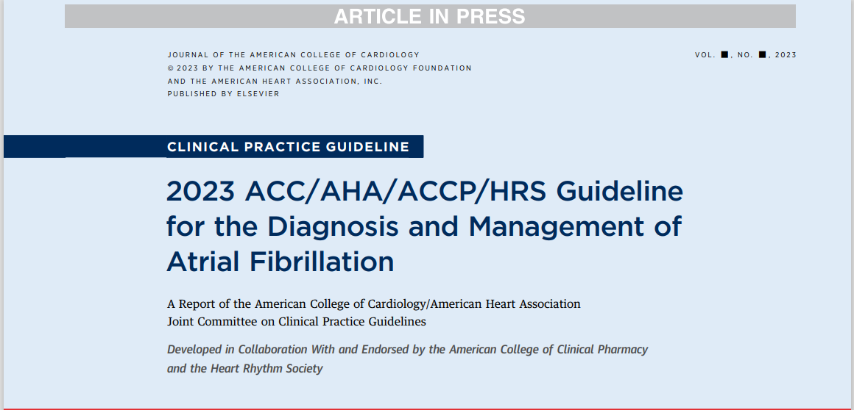

Slide 3
Atrial fibrillation (AF) is the most sustained common arrhythmia, and its incidence and prevalence are increasing globally
The increasing burden is multifactorial
The estimated global prevalence was 50 million in 2020
Notes:
2point: causes include the aging of the population, rising tide of obesity, increasing detection, and increasing survival with AF and other forms of cardiovascular disease (CVD).

Slide 4
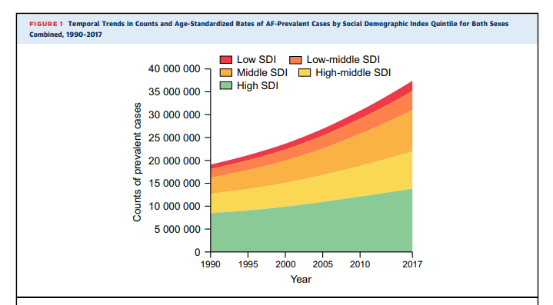
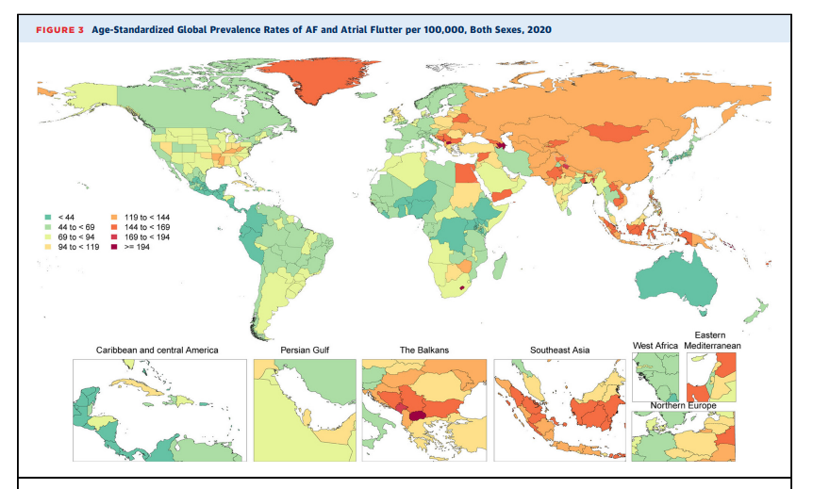
Notes:
Prevealance of AF in the world

Slide 5
RISK FACTORS:
Advancing Age
Smoking
Physical activity
Alcohol
Adipose Marker/BMI
Height
Hypertension
Resting Heart Rate
Diabetes
CAD
VHD
Post Cardiac Surgery
Conditions: CKD/OSA/Thyroid disease/Sepsis
Marker on ECG: PR interval/ LVH
Biomarkers: BNP, Inflammatory markers(IL-6/CRP/TNF),Lp(a)
Imaging: LA Size/ LV wall thickness

Slide 6
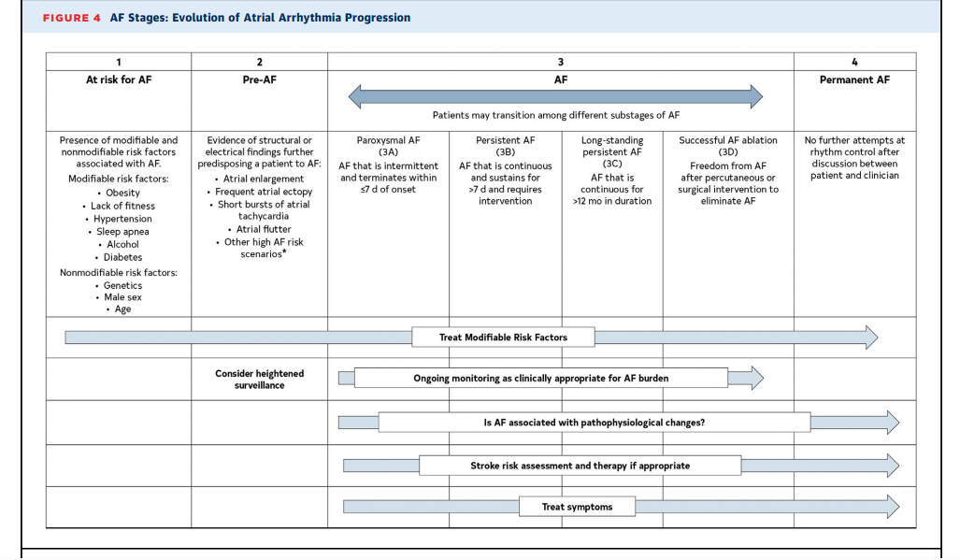
Atrial Arrhythmia Classification and Definitions
Notes:
Permanent AF: Permanent AF A term that is used when the patient and clinician make a joint decision to stop further attempts to restore and/or maintain sinus rhythm Acceptance of AF represents a therapeutic decision and does not represent an inherent pathophysiological attribute of AF

Slide 7
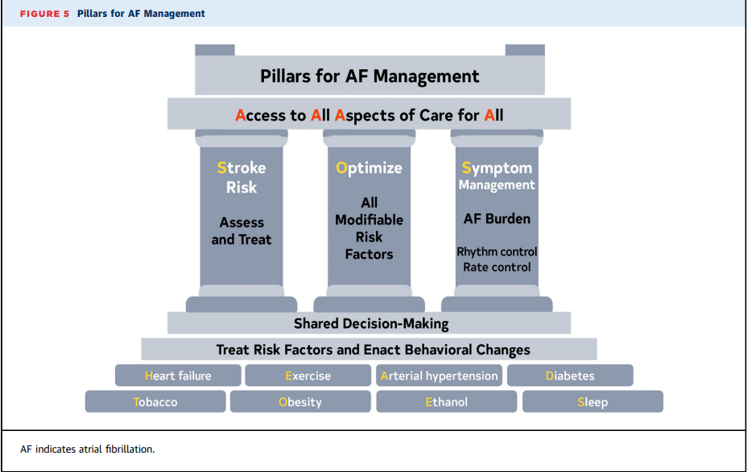

Slide 8
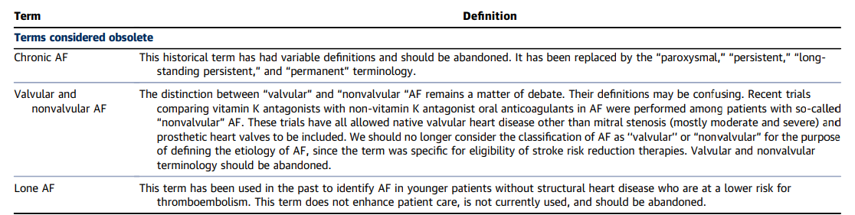
Notes:
Valvular AF vs Non valvular AF

Slide 9
Atrial Flutter
Typical AFL or “cavotricuspid isthmus (CTI)-dependent AFL, involves a macroreentrant circuit around the tricuspid annulus traversing the CTI on the right side of the heart .
If the flutter involves a different circuit than tricuspid valve/isthmus, then it is called “atypical” AFL, which is also known as “noncavotricuspid isthmus–dependent macroreentrant AT
Notes:
This is the arrhythmia associated with the classic electrocardiogram (ECG) finding of sawtooth flutter waves in the inferior leads when the circuit goes in the counterclockwise direction. The same circuit in the clockwise direction is called “reverse typical AFL.”

Slide 10
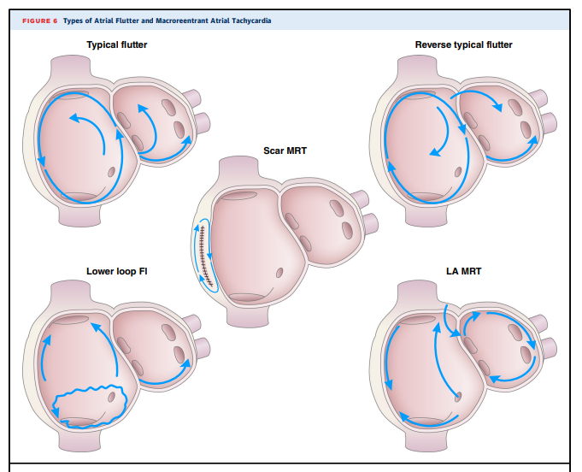
Notes:
The typical, reverse typical, and the lower-loop flutter all have the low right atrial isthmus incorporated in the flutter circuit. Other macroreentrant flutters include scar mediated reentrant tachycardia and left mitral isthmus flutter.

Slide 11
Electrophysiological Mechanism Leading to AF
PV features that increase vulnerability for initiating ectopy include a higher resting membrane potential, stretch activated channels and pattern of cross myofiber orientation
Down regulation of connexin results in decreased gap junctions, leading to slow heterogeneous atrial conduction velocity and repolarization.
Calcium mishandling from remodeling increases calcium load in the sarcoplasmic reticulum and dysfunction of ryanodine receptors, which regulate intracellular calcium release

Slide 12
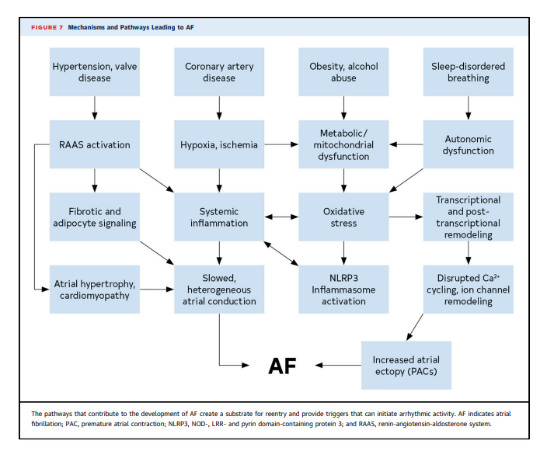

Slide 13
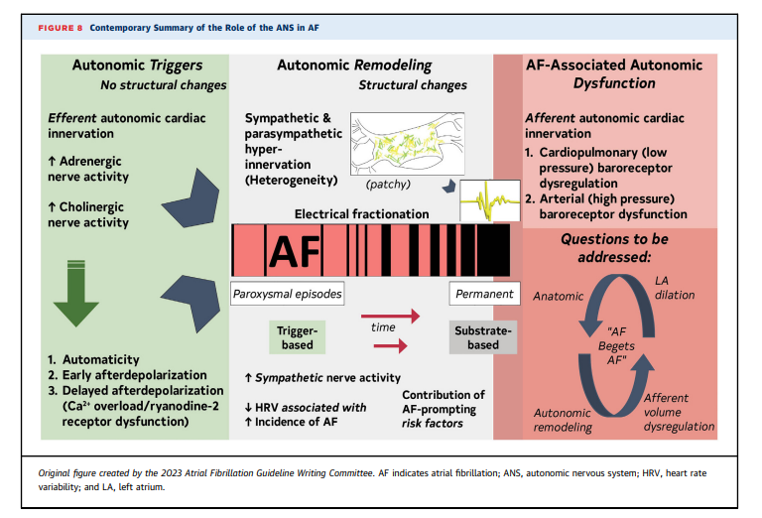
Notes:
ROLE OF ANS IN AF

Slide 14
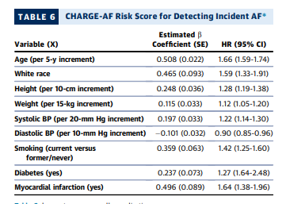
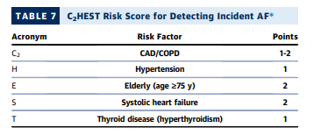
Risk Stratification and Population screening
Notes:
*Five-year risk is given by: 1 – 0.9718412736exp(SbX – 12.4411305), where beta is the regression coefficient (column 2) and X is the level of each variable risk factor.
2
C2HEST SCORE MAXIMUM IS 8; INCIDENCE OF AF SIGNFICANTLY INCREASES WITH HIGH SCORE

Slide 15
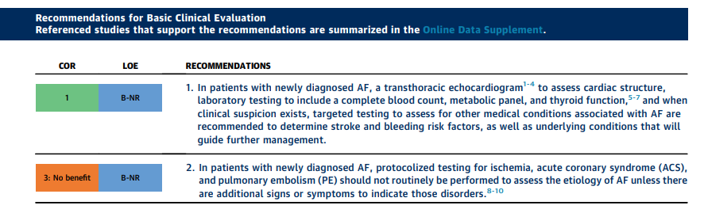

Slide 16
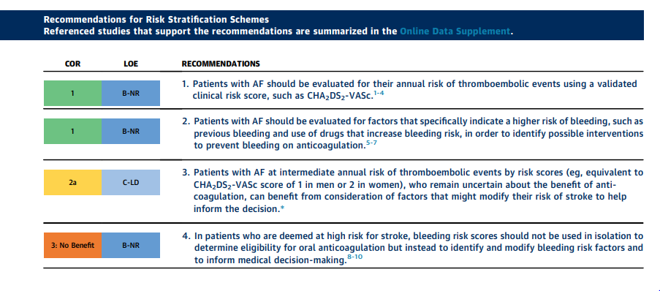
Prevention of Thromboembolism

Slide 17
3 VALIDATED RISK FOR STROKE
CHA2DS2-VASc2
ATRIA
GARFIELD
Notes:
ATRIA indicates Anticoagulation and Risk Factors in Atrial Fibrillation:
GARFIELD-AF, Global Anticoagulant Registry in the Field-Atrial Fibrillation; and TIA, transient ischemic attack

Slide 18
Newer risk scores, such as the ATRIA and GARFIELD-AF include renal disease parameters scores, modestly improve risk discrimination compared with CHA2DS2-VASc
Both new score calibration and risk reclassification performance has not been as rigorously evaluated
GARFIELD-AF adds additional variables to consider, such as smoking status, renal disease, and dementia.
Notes:
The CHA2DS2-VASc score is considered the most validated score, most therapies have used that score to prove efficacy, and thus CHA2DS2-VASc is generally the preferred score

Slide 19
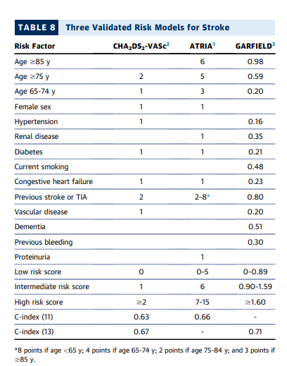
Notes:
ATRIA indicates Anticoagulation and Risk Factors in Atrial Fibrillation:
GARFIELD-AF, Global Anticoagulant Registry in the Field-Atrial Fibrillation; and TIA, transient ischemic attack

Slide 20
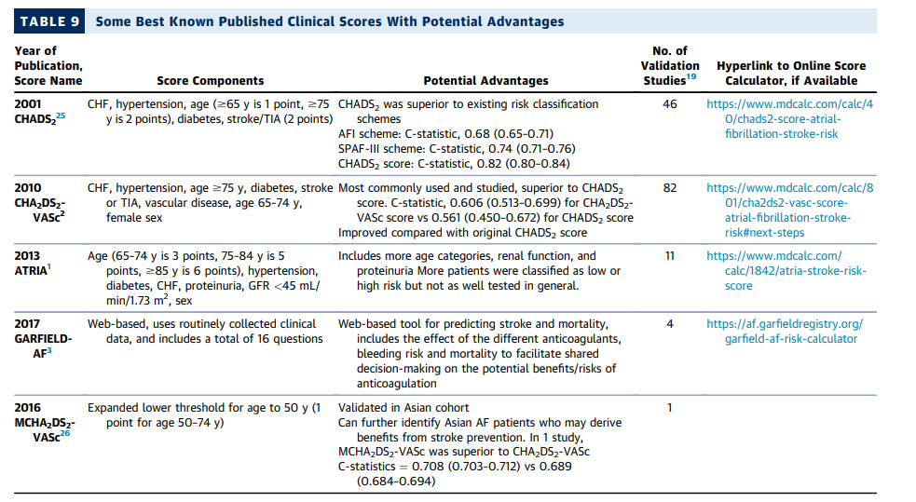

Slide 21
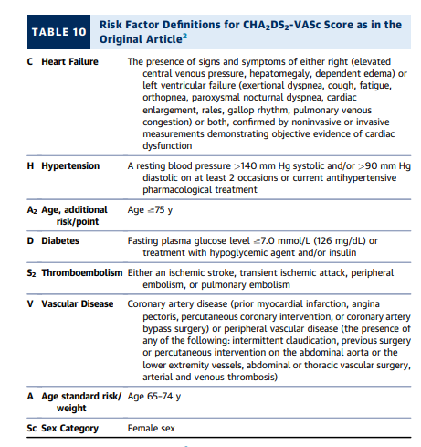
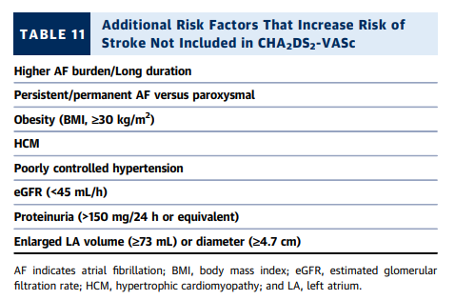
Notes:
The decision to treat with OACs for stroke prevention in patients with a CHA2DS2-VASc of 1 (CHA2DS2-VASc of 2 in women) may at times require additional discussion with patients as the strength or recommendation is less robust (2a)

Slide 22
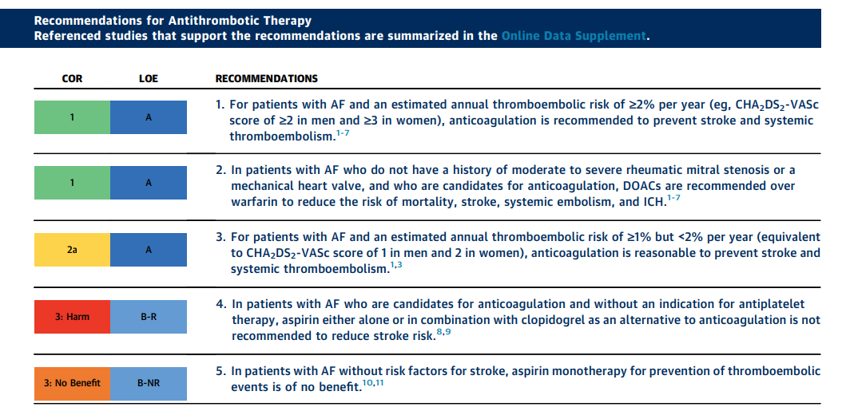
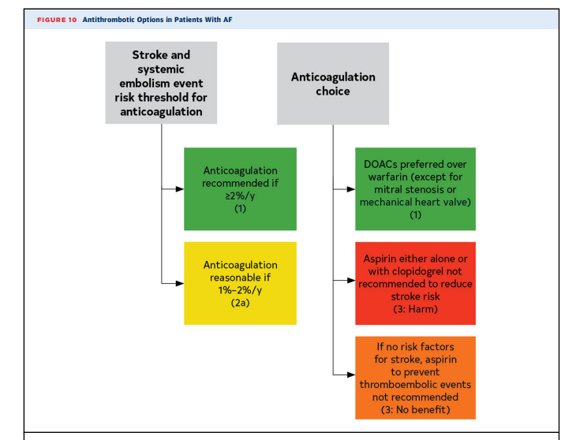

Slide 23
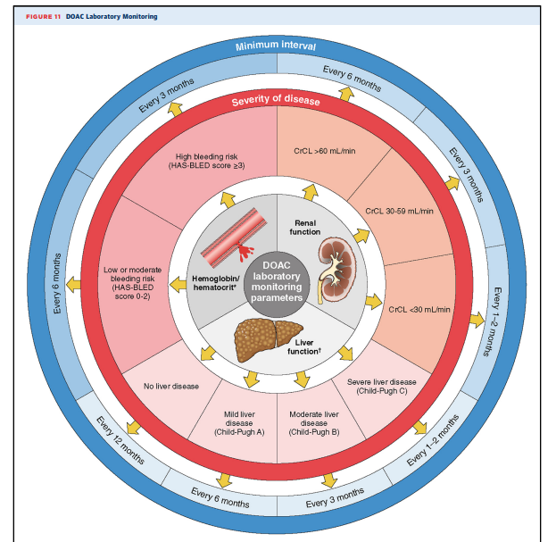
Notes:
HAS BLED: HTN, ABNORMALLFT STROKE BLEEDING, LABILE INR ELDERLY DRUGS

Slide 24
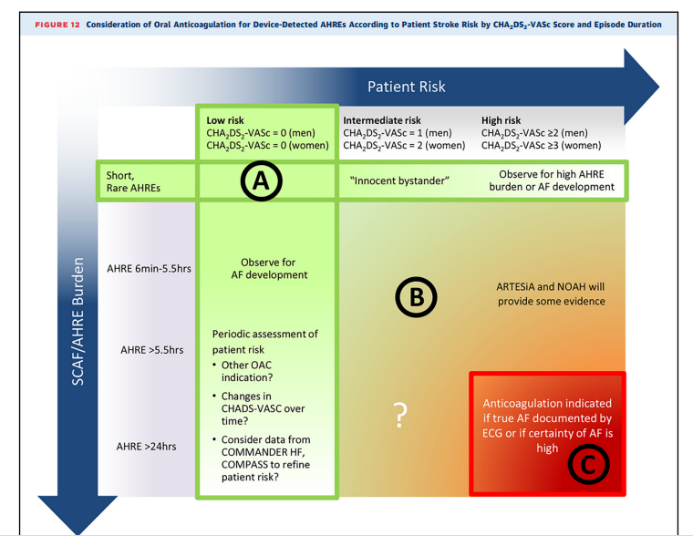
Notes:
AHREs (atrial high rate episode)detected by a cardiovascular implantable electronic device are associated with a stroke risk lower than that of clinical AF.
A potential approach to patients with SCAF could consider both patient risk (as gauged by the CHA2DS2-VASc score) and SCAF burden/duration. Circle A indicates patients at low risk or with short and infrequent AHREs do not require anticoagulation; Circle B, patients with intermediate risk and AHREs lasting >6 min to 24 h are an uncertain population but are currently under study in 2 prospective randomized controlled trials; and Circle C, patients at high risk with longer episodes could be considered reasonable candidates for anticoagulation, although the precise threshold for SCAF duration remains uncertain. AF indicates atrial fibrillation; AHRE, atrial high-rate episode; ARTESiA, Apixaban for the Reduction of Thrombo-Embolism in Patients With Device-Detected Subclinical Atrial Fibrillation trial; COMMANDER HF, A Study to Assess the Effectiveness and Safety of Rivaroxaban in Reducing the Risk of Death, Myocardial Infarction, or Stroke in Participants With Heart Failure and Coronary Artery Disease Following an Episode of Decompensated Heart Failure; COMPASS, Cardiovascular Outcomes for People Using Anticoagulation Strategies; ECG, electrocardiogram; NOAH, Non–Vitamin K Antagonist Oral Anticoagulants in Patients With Atrial High Rate Episodes Trial; OAC, oral anticoagulation; and SCAF, subclinical atrial fibrillation. Female sex is treated as a modifier in the computation of the CHA2DS2-VASc score.

Slide 25
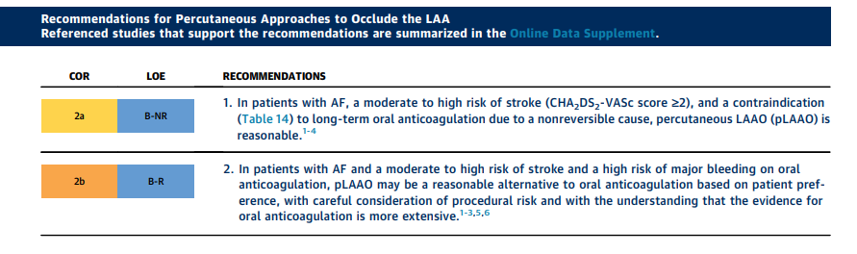
LAAO
RCTs have demonstrated pLAAO to be noninferior to warfarin and DOACs for stroke and systemic embolism with a reduced risk of major bleeding.
Notes:
OACs may be contraindicated in some patients

Slide 26
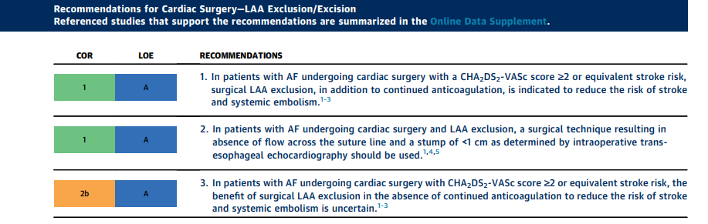
LAA EXCISION
Notes:
Intraoperative TEE was recommended to assess successful closure, defined as absence of flow across the suture line and a stump of < 1cm

Slide 27
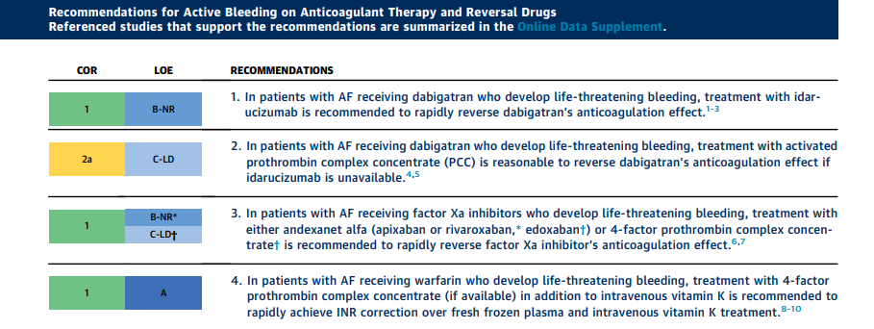
ACTIVE BLEDDING AND REVERSAL

Slide 28
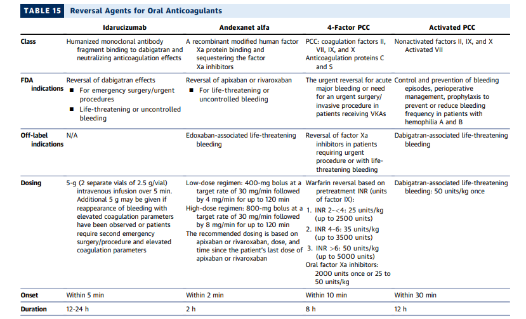
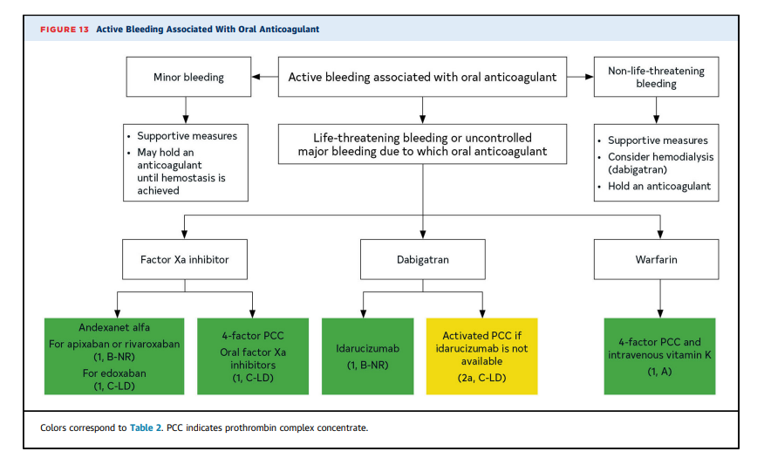

Slide 29
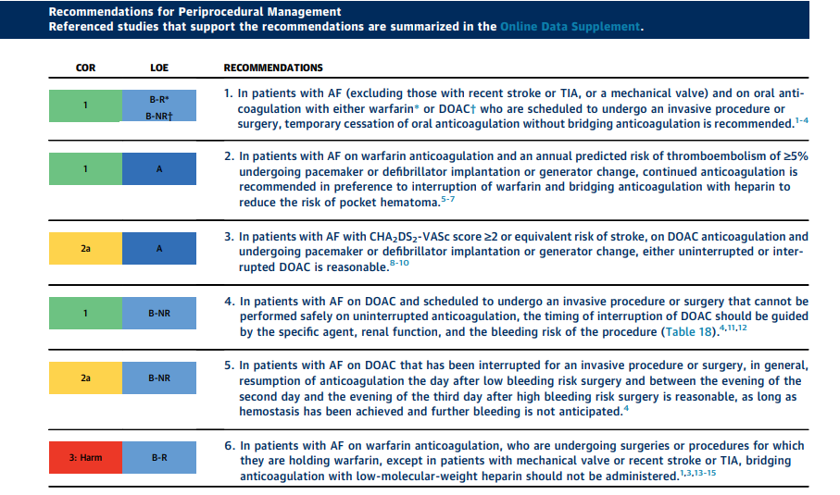
Periprocedural Management

Slide 30
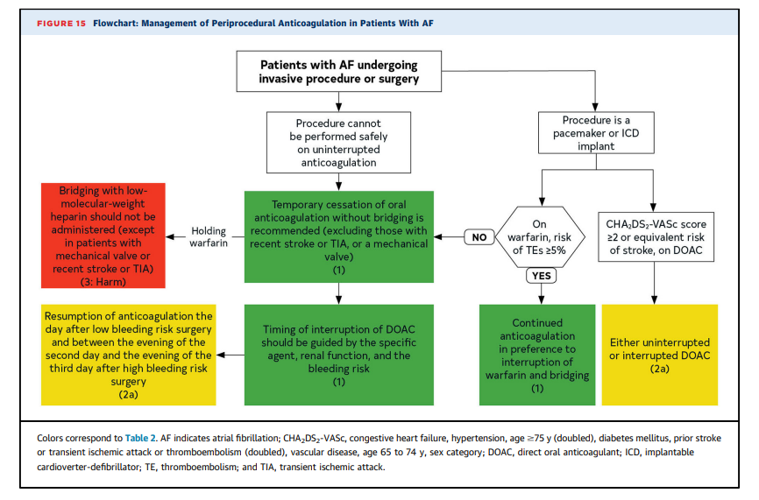

Slide 31
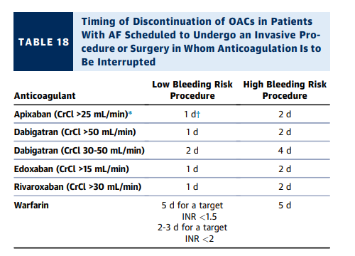
The BRIDGE (Bridging Anticoagulation in Patients who Require Temporary Interruption of Warfarin Therapy for an Elective Invasive Procedure or Surgery) trial included patients with a mean CHADS2 score of 2.3 (range, 1-6); 61.7% of patients had a CHADS2 score <3
RESULT: interruption of warfarin without bridging anticoagulation was superior to bridging.

Slide 32
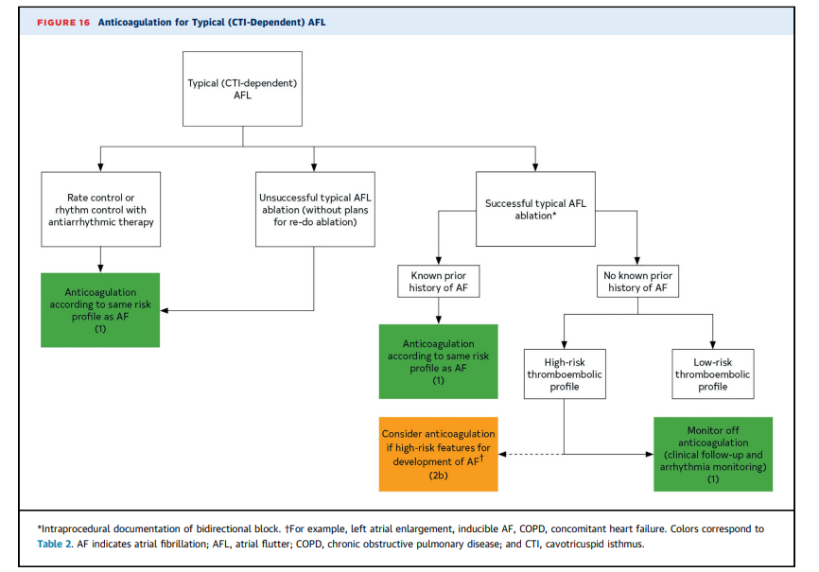
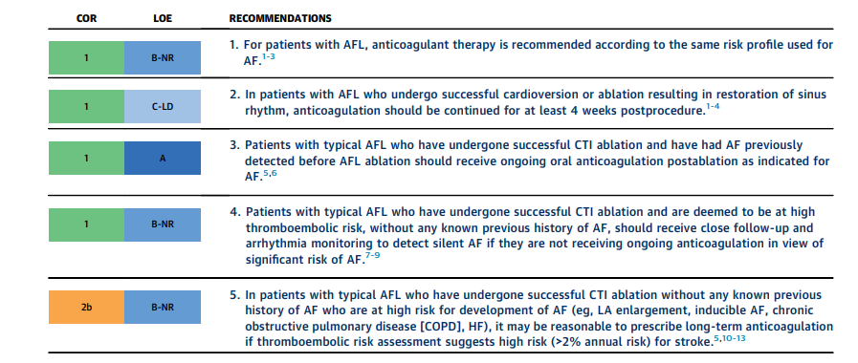
Anticoagulation in Atrial flutter

Slide 33
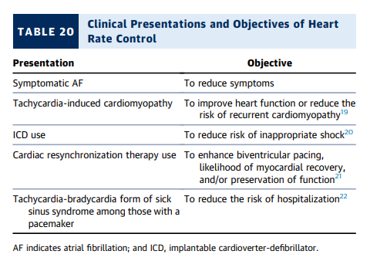
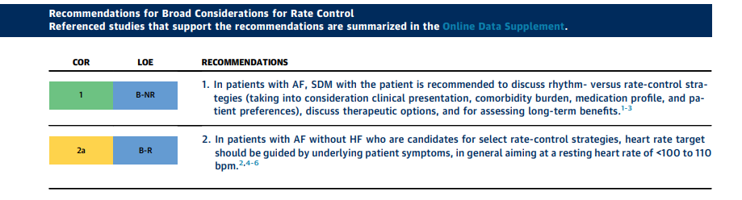
Rate Control

Slide 34
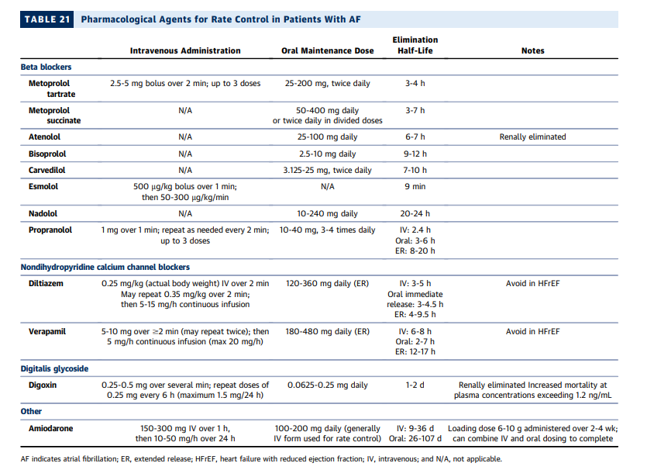

Slide 35
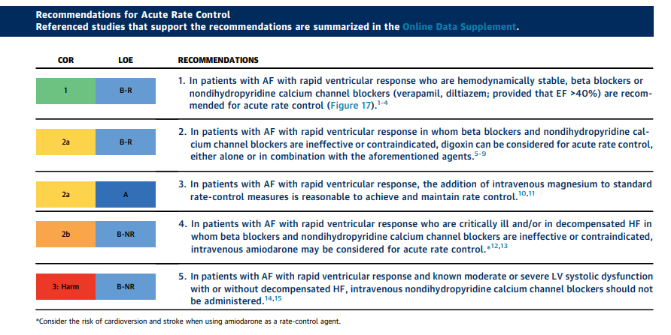
Acute Rate Control

Slide 36
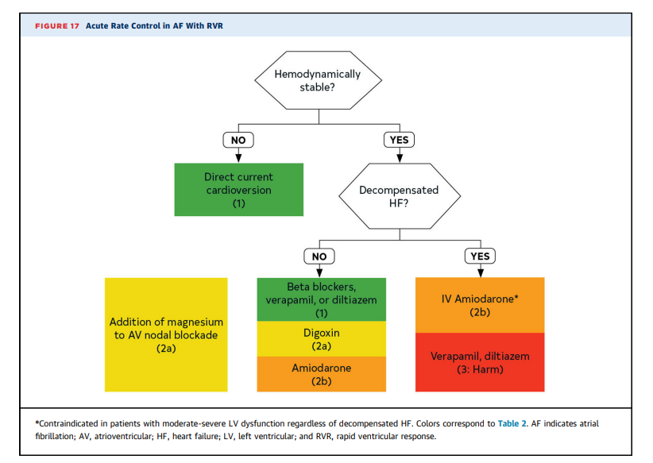

Slide 37
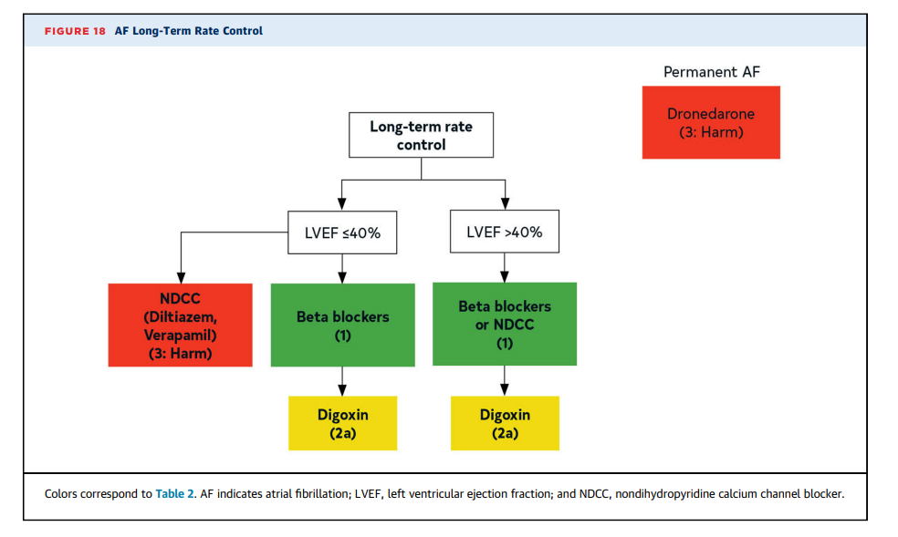

Slide 38
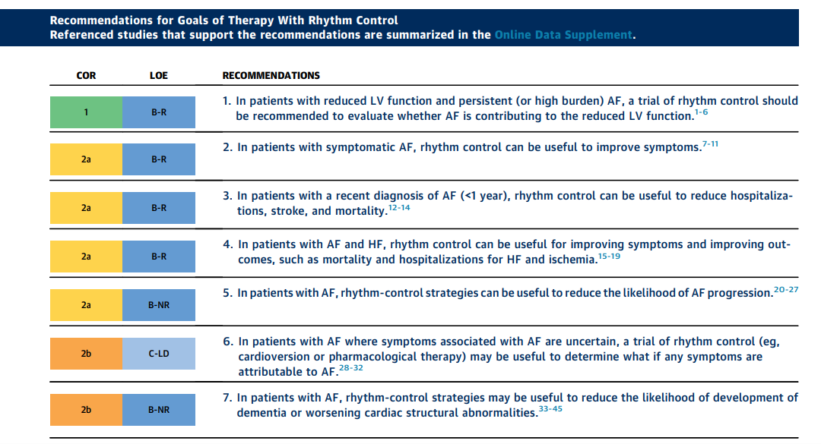
Rhythm Control

Slide 39
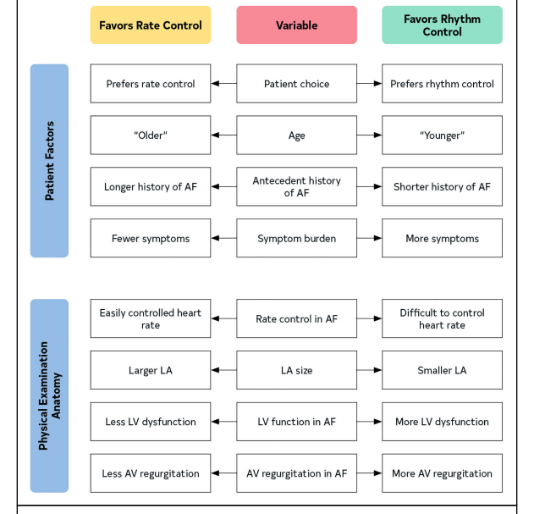
Rate Vs Rhythm Control

Slide 40
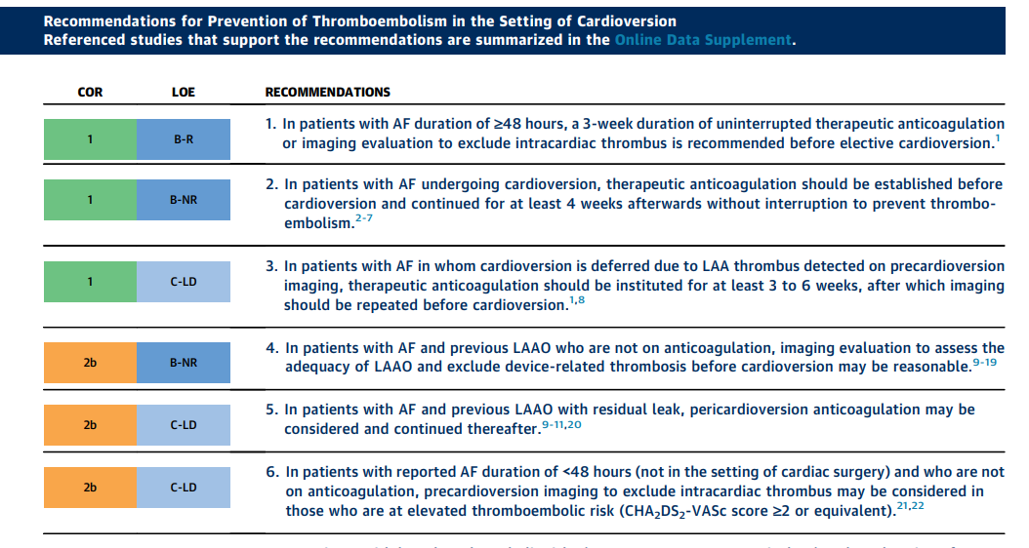
Prevention of Thromboembolism

Slide 41
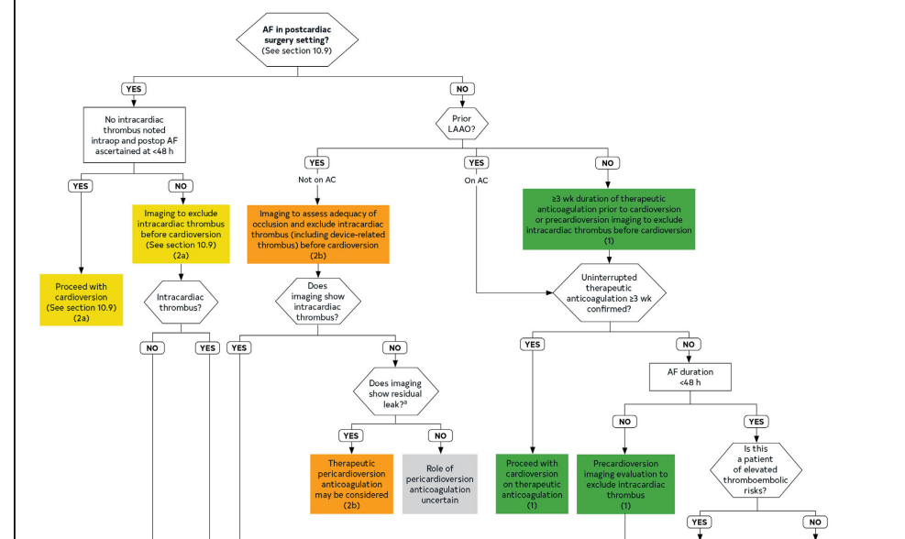
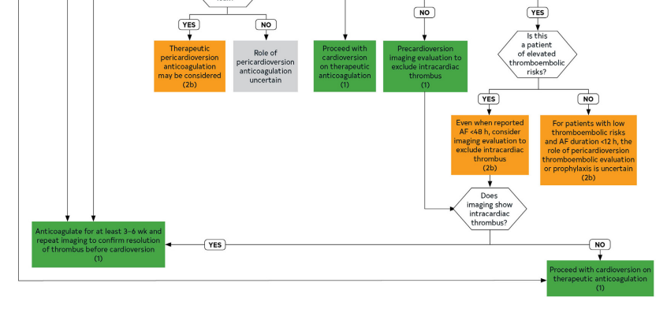
AF PLANNED FOR CARDIOVERSION

Slide 42
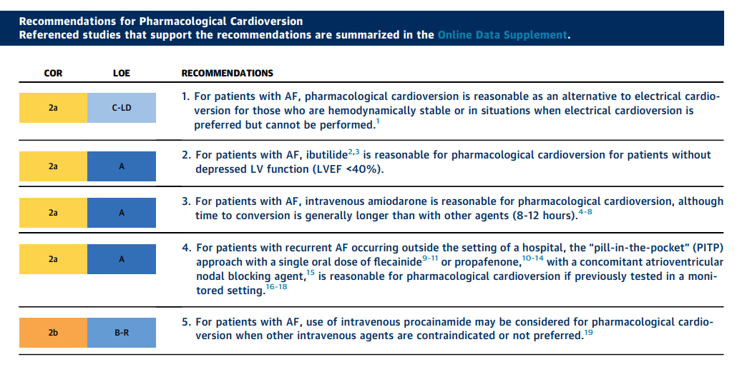
Pharmacological Cardioversion

Slide 43
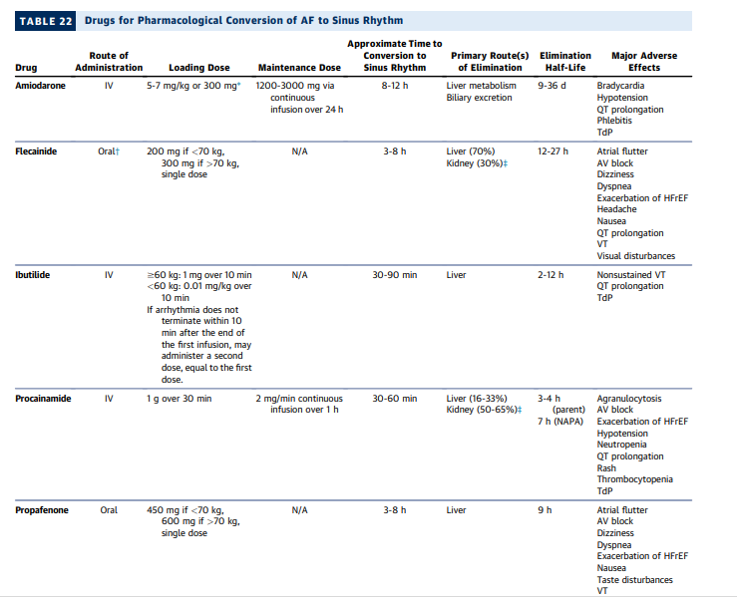

Slide 44
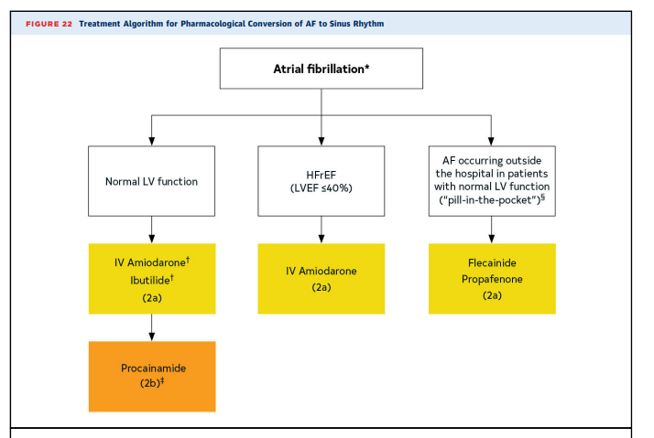
Pharmacological Cardioversion of AF to Sinus Rythm

Slide 45
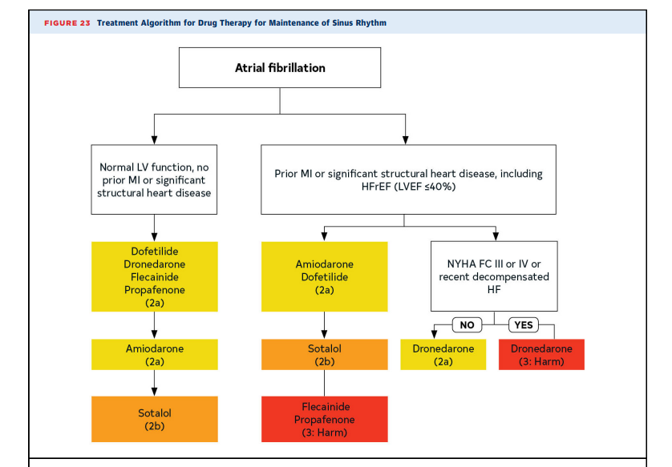
Maintenance of Sinus Rhythm

Slide 46
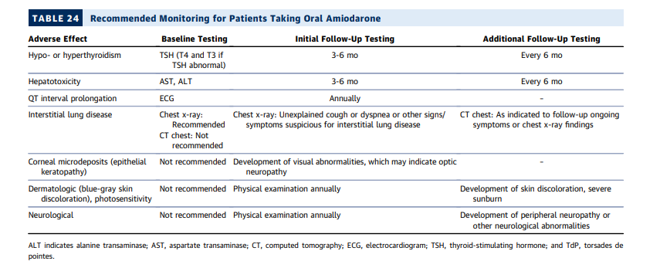
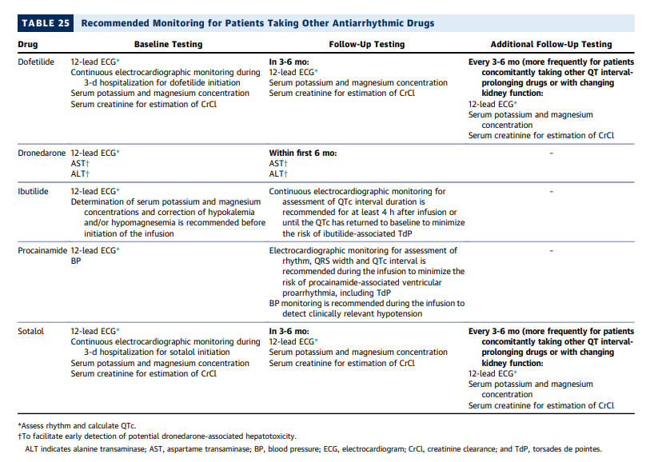
Monitoring of Oral Antiarrthymic

Slide 47
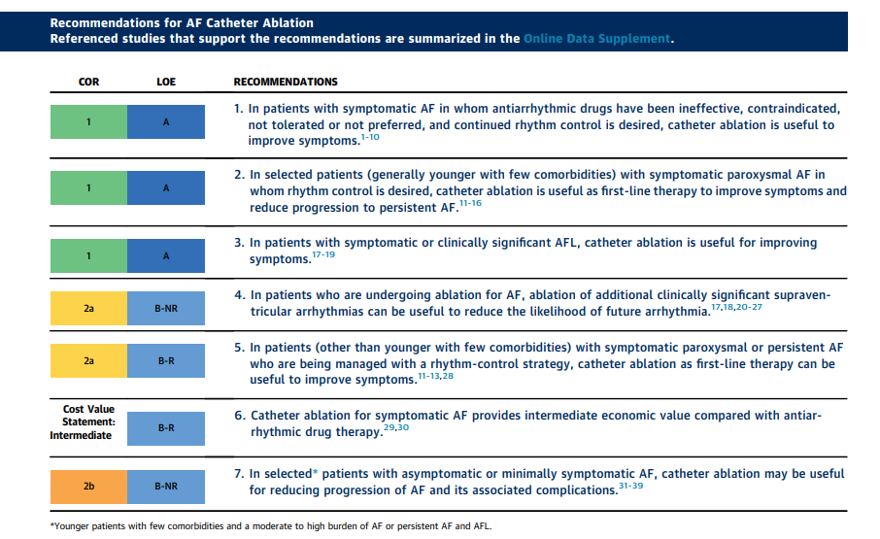
Catheter Ablation

Slide 48
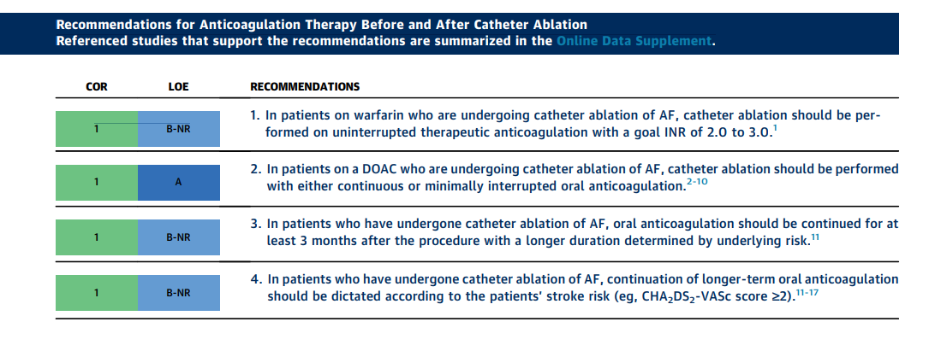

Slide 49


Slide 50

Management of AF with Heart Failure

Slide 51

Notes:
Randomized Trials of Rhythm Control in H

Slide 52


HEART FAILURE + AF

Slide 53
AF IN SPECIAL CIRCUMSTANCES
AF during illness
Pregnancy
After cardiac surgery

Slide 54

Prevention of AF after Cardiac Surgery

Slide 55

Treatment of AF after cardiac surgery

Slide 56


AF in Critical Care

Slide 57

AF in Pregnancy

Slide 58


Slide 59
THANK YOU

